Slide 1
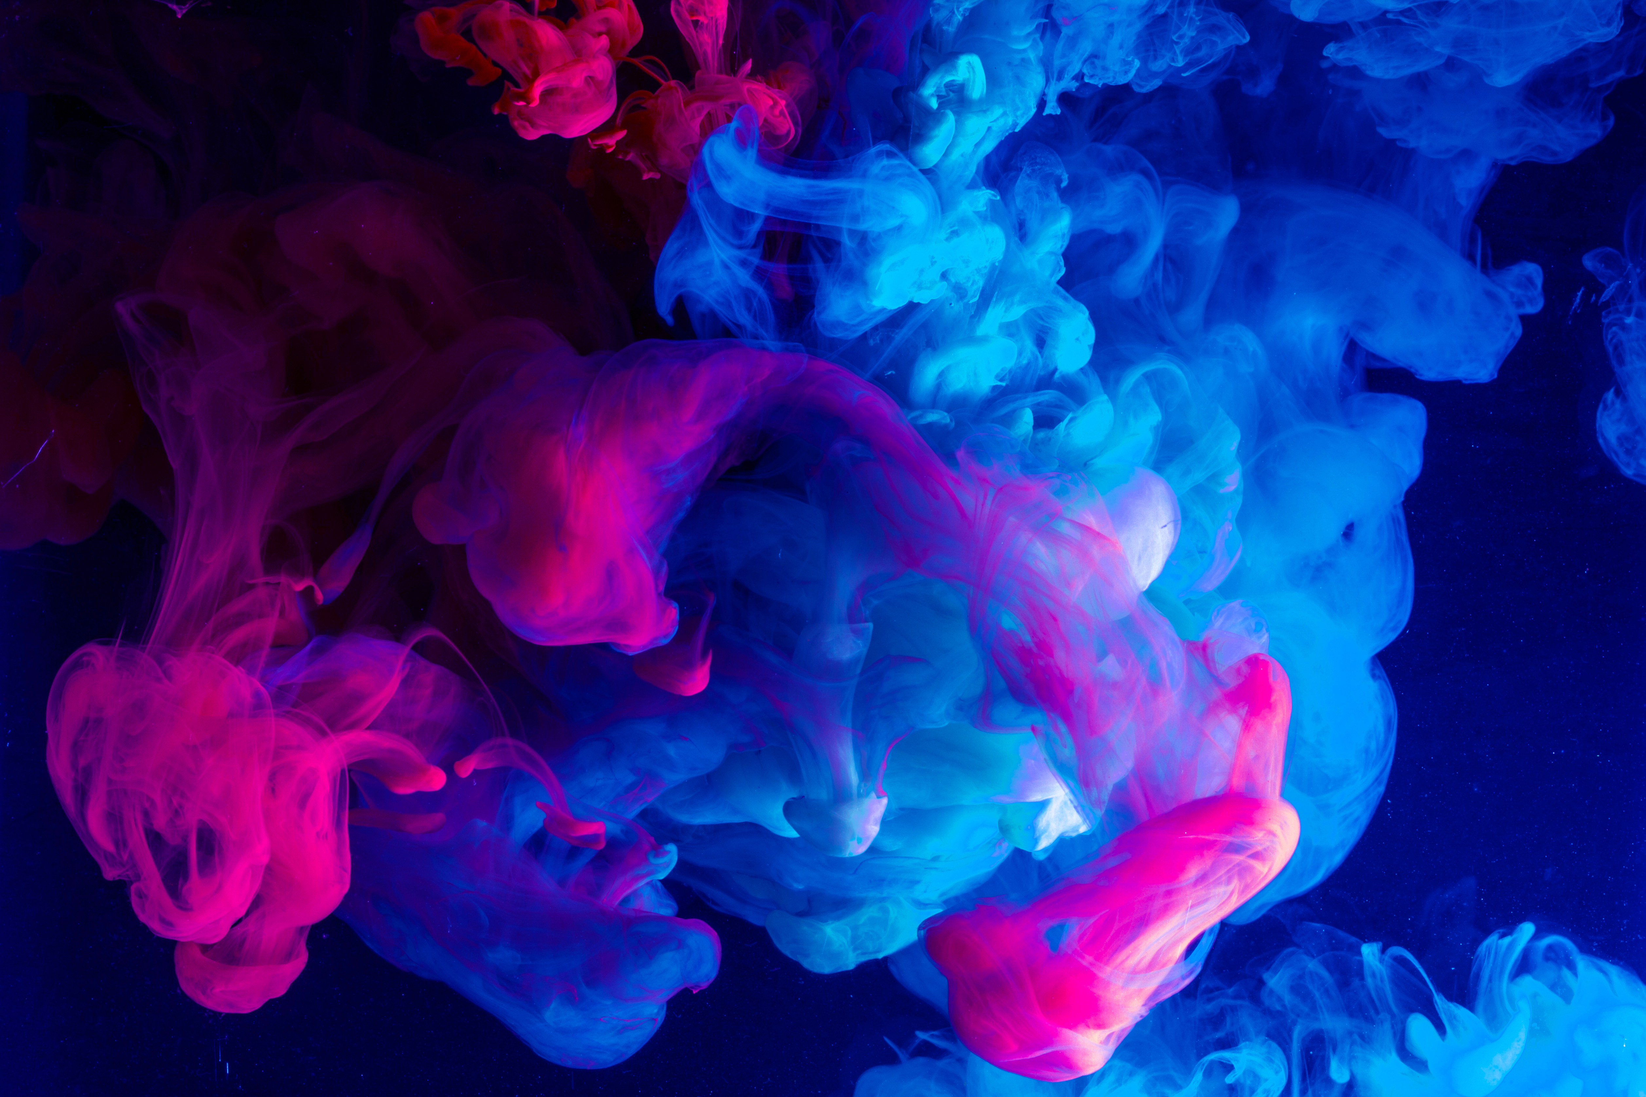


Case Maker: XXX
(the name of competitor)

Slide 2


These items could be helpful, so please read carefully:
The original image or image with high definition is necessary, so it is suggested to use devices like camera or iPhone.
This template is changeable, but it should still contain the content it had.
Please do not replace the screenshot of designing with a video.
The photos of side label and milled restoration on the disc are needed.
It is necessary to provide intraoral photo to proof the competitive case is a real case.
The assessment is based on shape aesthetic, shade bionic and photo presentation of the staining case.

Slide 3
The basic information of the case
Gender of the patient:
The intraoral situation:
Shade:
Other requirements from the dentist:
Plan of case:
Other information:

Slide 4
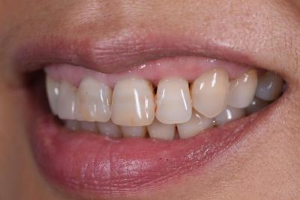
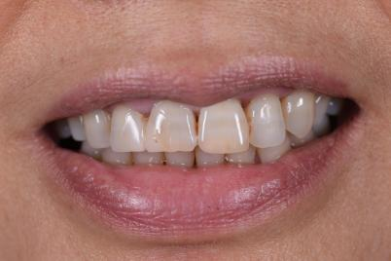
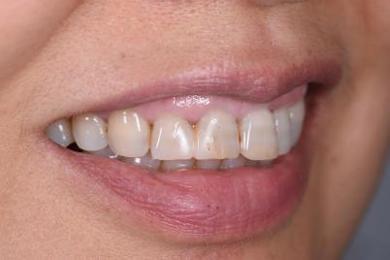
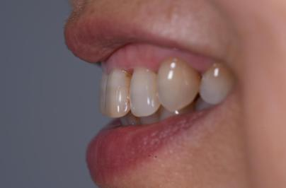
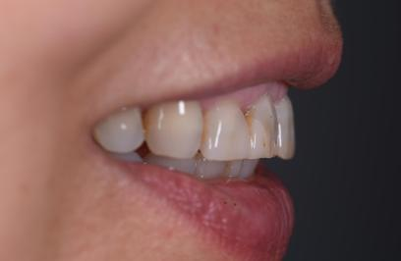
Intraoral photography before tooth preparation:

Slide 5

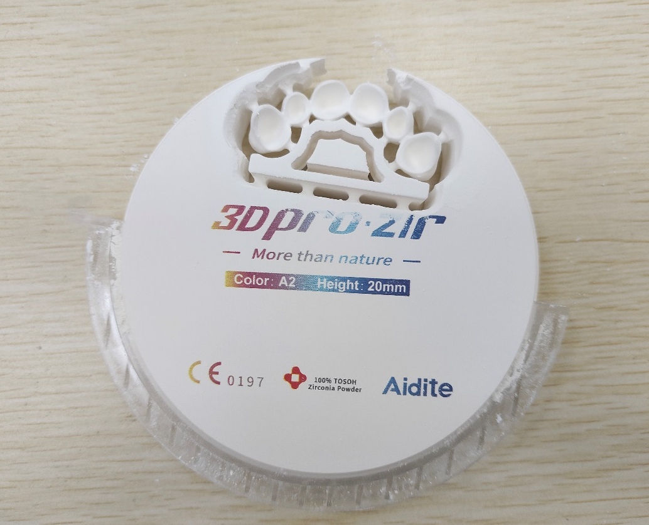
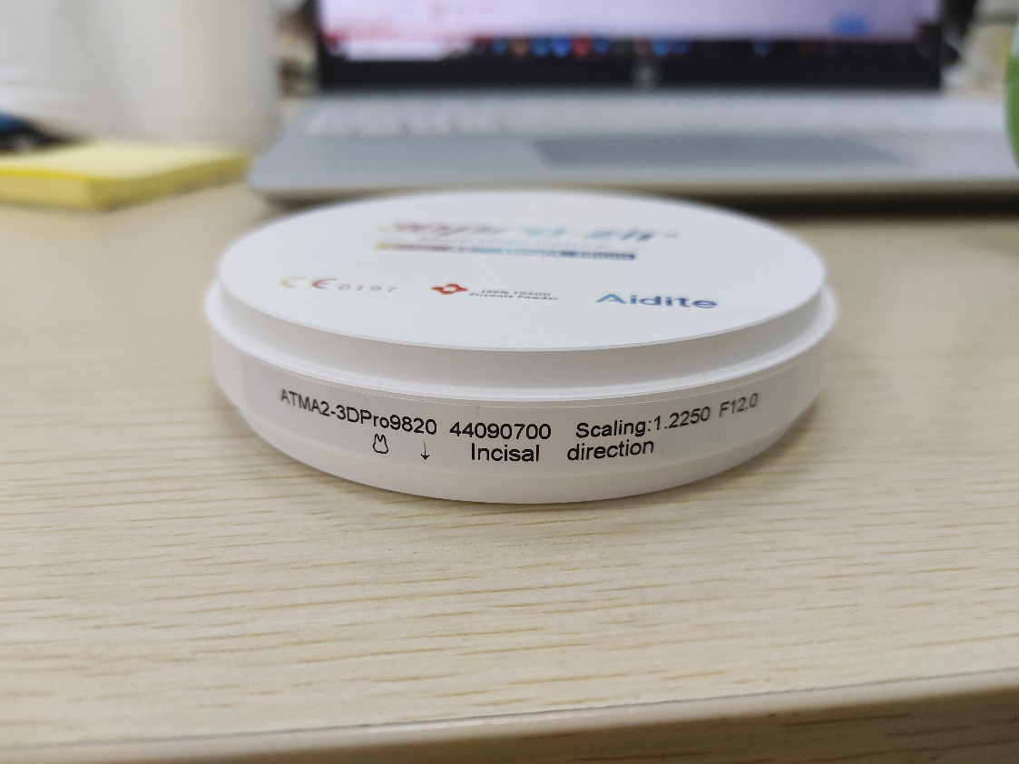
The photos of side label of 3D Pro and milled restoration:
Side label of 3D Pro
Milled restoration
（from the logo side）

Slide 6
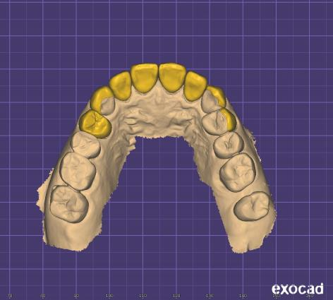
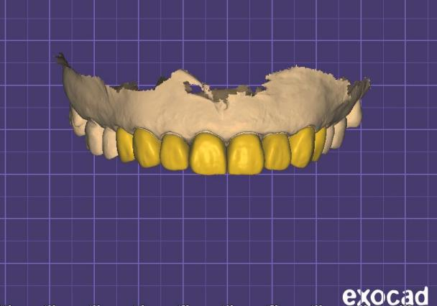
The photos of designing (at least 4):
The incisal side
The buccal side

Slide 7
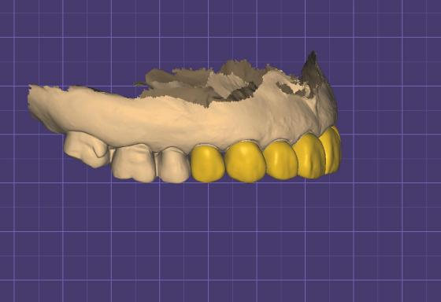
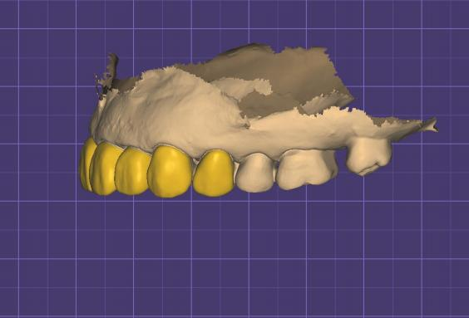
The photos of designing (at least 4):
The distal side
The mesial side

Slide 8
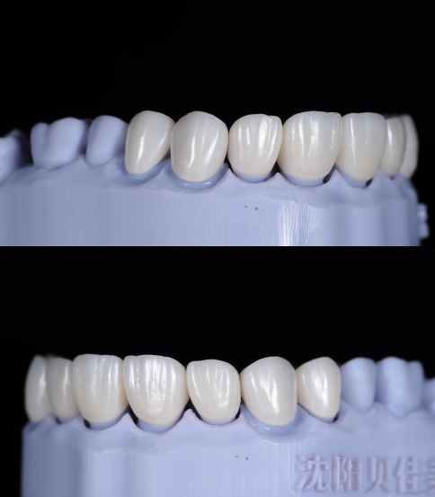
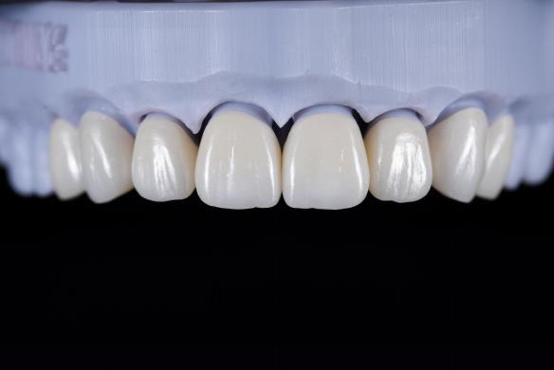
The photos before and after grinding and polishing (the buccal side)
Before grinding and polishing
After grinding and polishing

Slide 9
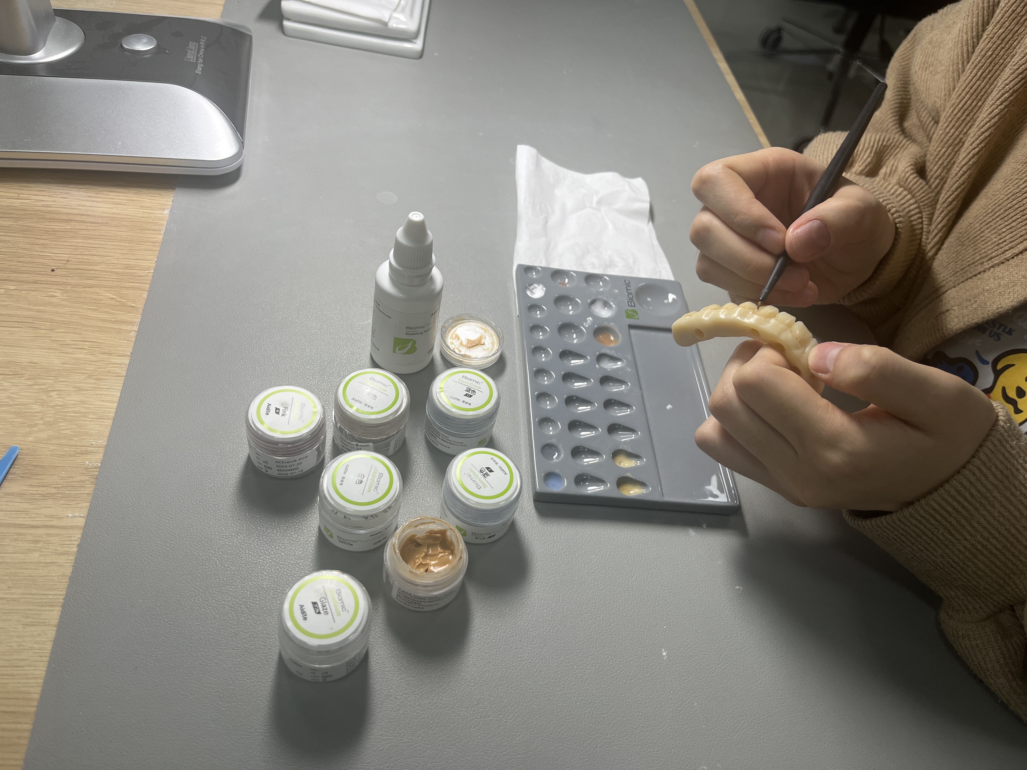
The photo of using Biomic
(please take a photo of the technician doing staining by Biomic and list colors the technician use for different areas)
Used colors:
1) Shade A (main area)
2) Terrocatto+brown (margin)
3) Blue 1 (line angle)
4) Blue2+black (incisal area)
5) White (halo effect)
…

Slide 10
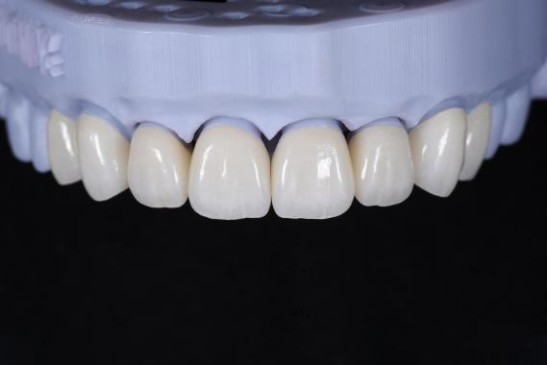
The photos of staining (at least 4)
The buccal side

Slide 11
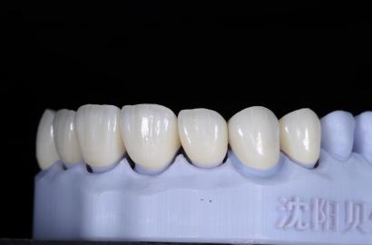
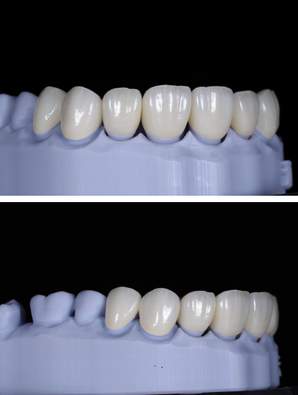
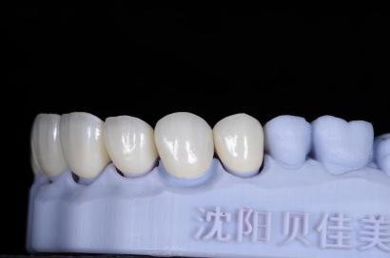
The photos of staining
The occlusal side

Slide 12
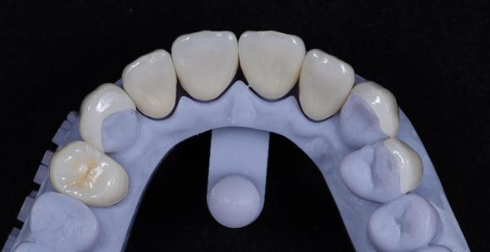
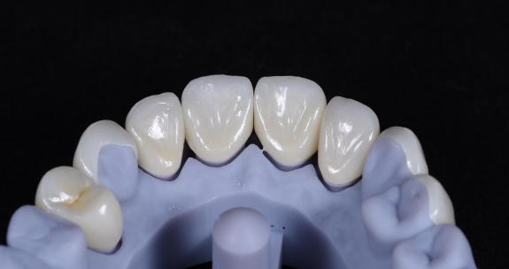
The photos of staining
The lingual side

Slide 13
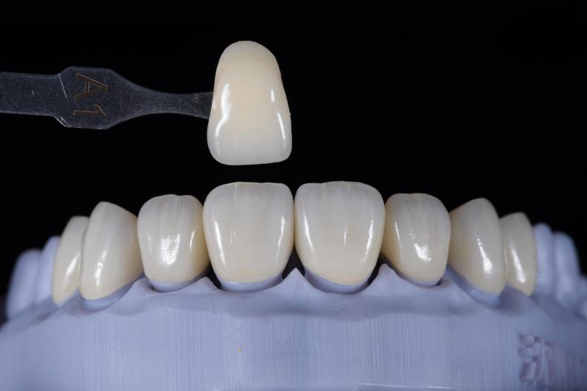
The photo of comparing with shade guide

Slide 14
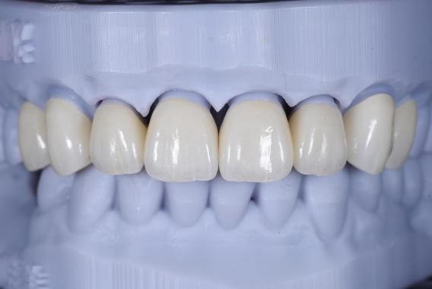
The photos of occlusion (at least 3):
The buccal side

Slide 15
The photos of occlusion (at least 3):

Slide 16
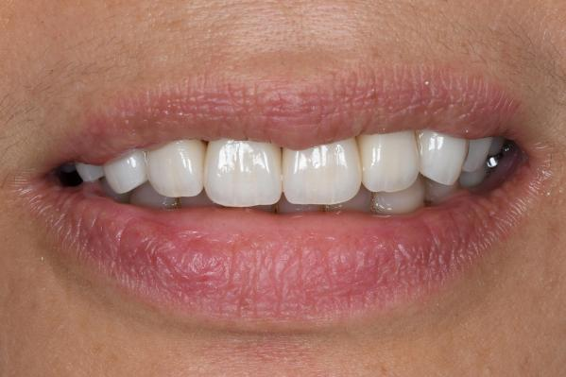
The intraoral photos
Before operation
After operation

Slide 17
Here you can add more photos you want to show

Slide 18
Thank You
Aidite International Dentistry Cup

